Slide 1
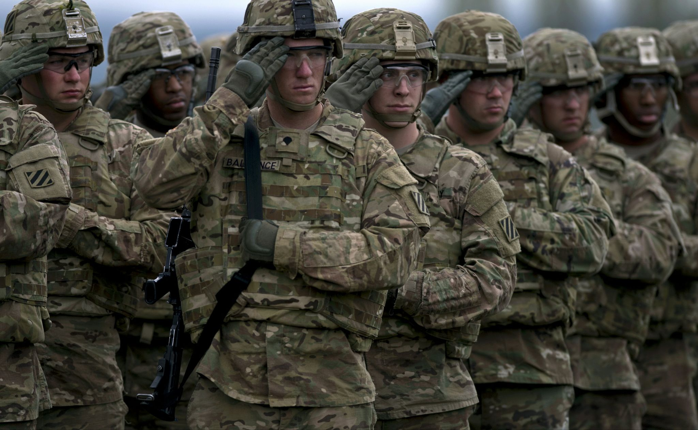
Soldier Demographics
A Capstone Project by Walter Castillo

Slide 2

About Me
Born in Honduras, March 6, 1998.
Joined the Army September 2017
Infantry Sergeant
Married
Junior in college pursuing a Computer Science Degree
Some hobbies of mine are computer games and golf.

Slide 3
Why Knowing Service Member Demographics matter.
New Army Culture
What we can do
Different Needs
The Army is moving in a new direction where its warfighting capabilities are becoming more focused on the soldier. Readiness is a huge importance to us as leaders of soldiers.
Knowing about things like soldiers marital status helps us better meet their needs.
Married soldiers have special needs like housing, childcare and family counseling
As a single soldier it is easy to feel like you are missing out on benefits compared to married soldiers. I believe single soldiers have different needs which need to be fulfilled as much as married soldiers needs.

Slide 4
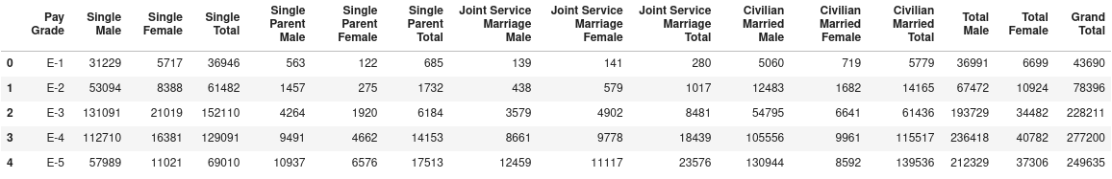
Looking Into The Data
Challenge 1
Challenge 3
Dataframe was acquired from Data.gov and was created in 2010 Data consists of active duty service members by rank and the total amount by marital status. The ‘Pay Grade’ column is categorical while the rest are numerical. Rows contain paygrades in ascending order from E-1 to O-10 There was no data missing or nan’s.

Slide 5
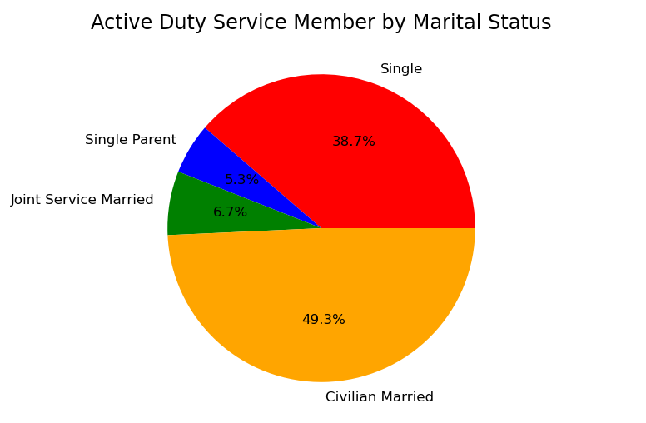
Data Exploring
This pie chart gives a quick visualization of how different marital statuses are distributed across all branches.

Slide 6
Results
Z test: 0.1
P value: 0.9
To test whether the population of married soldiers and unmarried soldiers has a significant difference I conducted hypothesis testing in the form of a z-test.
My results show that in fact there is no significant difference between the number of married and unmarried soldier.
My results can be important when deciding how to allocate programs to help both married and unmarried soldiers.
Often one can't help but notice the lack of programs provided for single soldiers and since both population are not significantly different the same amount of effort should be given to benefit single soldiers.

Slide 7
Additional Testing
When comparing the population of married enlisted and married officers I found the populations to not have a significant difference.
When comparing the population of single enlisted and single officers I found a similar results as previous tests.
In addition of testing whether the population of single and married soldiers showed a significant difference, I also tested whether the population of married and unmarried enlisted soldiers showed a significant difference to its officer counterparts.
Z test: 0.1
P value: 0.9
Z test: -1.2
P value: -0.6

Slide 8
Conclusion
According to the tests one can conclude that we should devote the same effort for married and unmarried service members.
In the future I would like to have access to more detailed and recent data. I would have also like to delve into other demographics like age and race.
What is Next?

Slide 9
Questions?
Walter.i.castillo.mil@mail.mil
Github.com/Waltercas

Slide 10
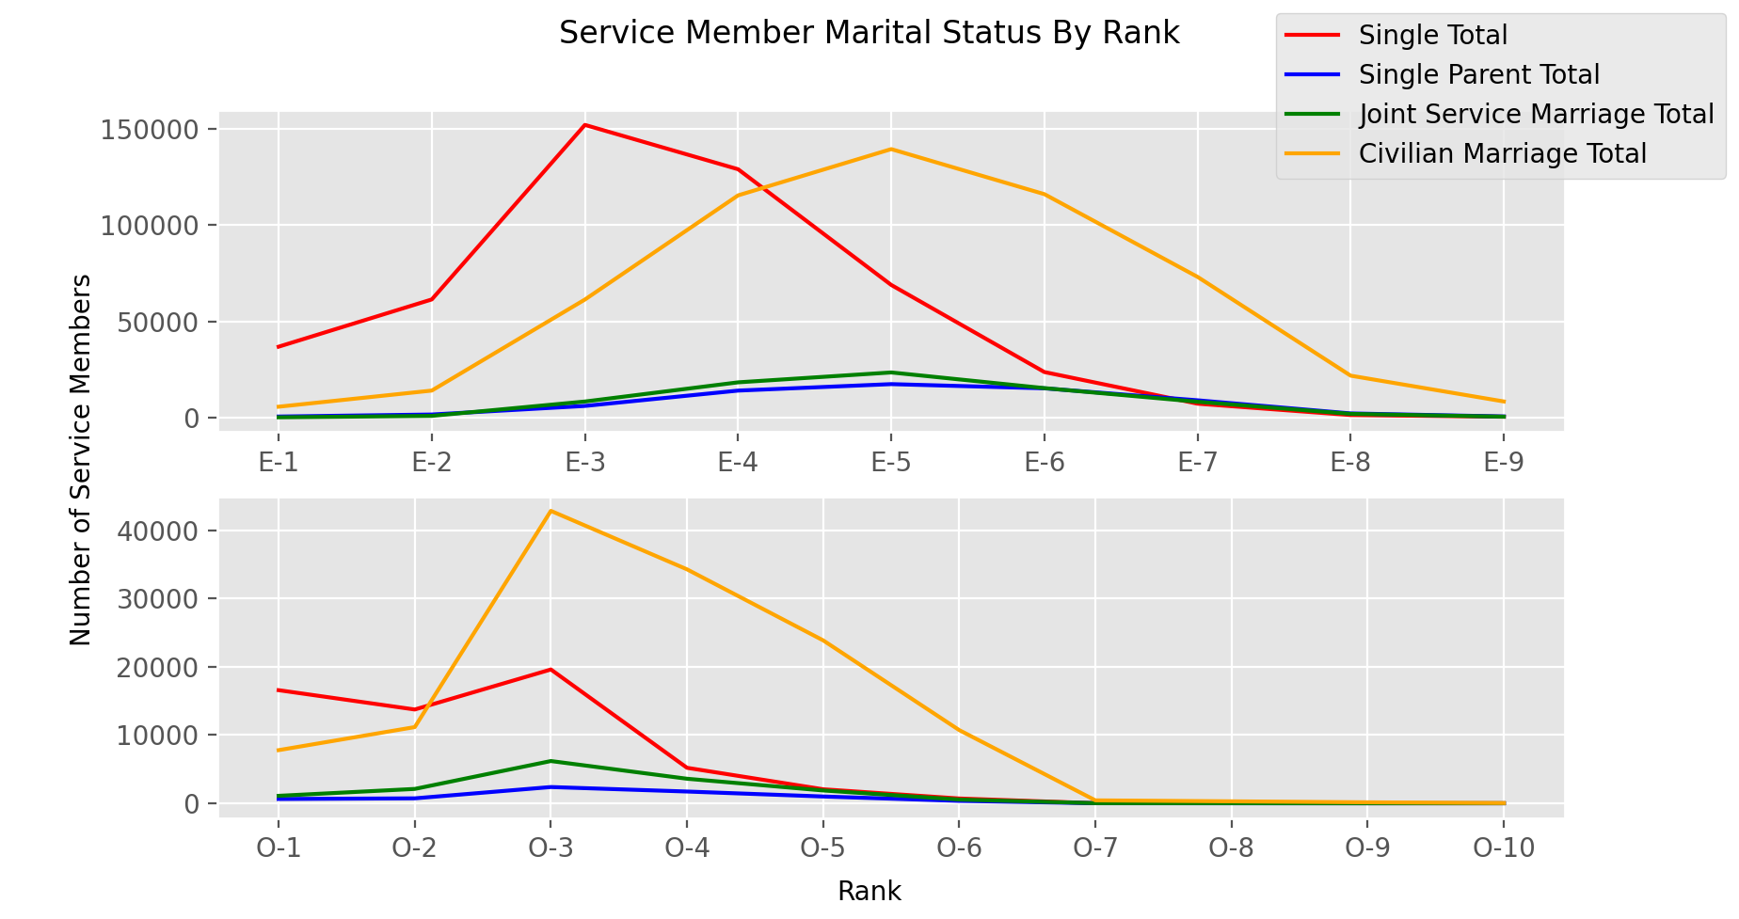

Slide 11
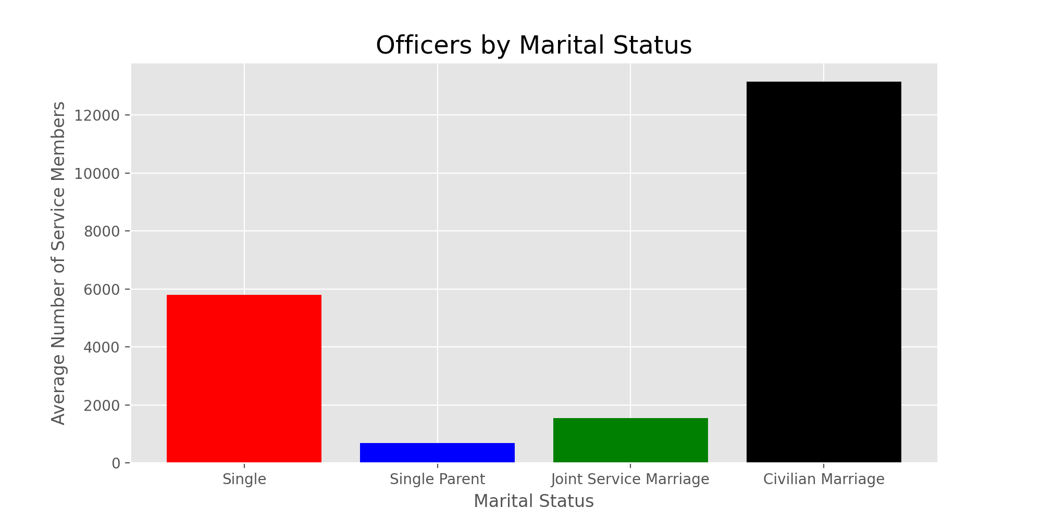

Slide 12
